Slide 1
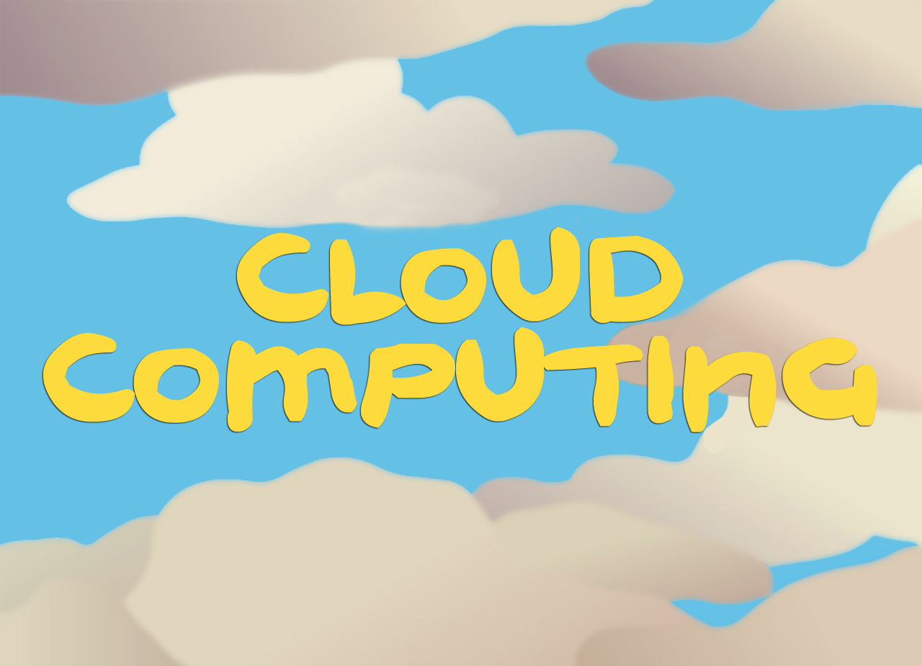

Slide 2

definition
Outline :
What is cloud computing ?
History.
Characteristics of Cloud Computing
Services provided by cloud computing.
Advantages and Disadvantages
Companies that offer cloud computing services.
Conclusion.
References.

Slide 3

What is cloud computing ?
“Cloud” is simply a metaphor for internet.
Cloud computing is defined as the storage, management, processing, and accessing information and other data stored in a specific server.
Users simply rent or access the software ,paying only for what they use
Introduction
19 NOV. 2016

Slide 4
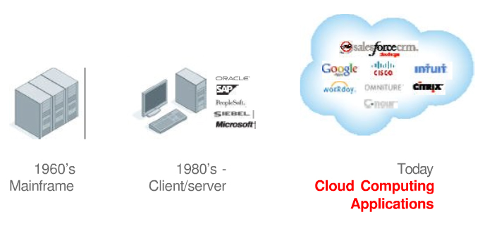
History
History
19 Nov.2016

Slide 5
Characteristics of Cloud Computing
On demand self services
Broad network access
Pay per use
Rapid Elasticity
Characteristics
19 Nov.2016

Slide 6
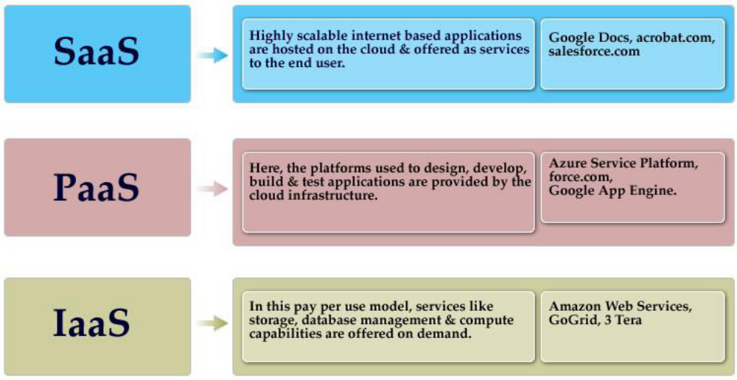
Services provided by cloud computing.
Services
19 Nov 2016

Slide 7


Advantages and Disadvantages
Advantages
Disadvantages
Lower software costs
Increase Storage
Improve performance
Unlimited Storage Capacity
Device Independence
Security
Internet Connection
Speed
19 NOV 2016

Slide 8
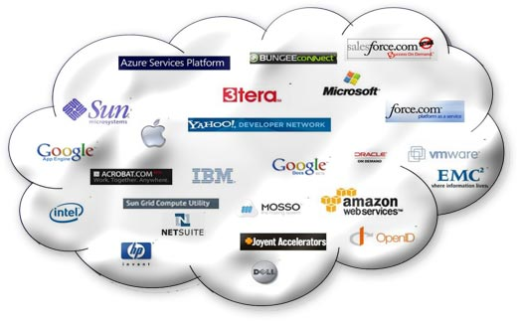
Companies that offer cloud computing services
19 Nov 2016

Slide 9
Conclusion
Future forecast of IT is cloudy .
More and more providers and services are emerging
Users can use everything they want, when they want it and pay only for what they use
Important prerequisite for cloud computing is high-speed Internet access .
Security is the main concern and obstacle to the cloud
19 Nov 2016

Slide 10
References
www.makeuseof.com/.../ cloud-computing-work-technology-explained/
http://cloud computing .sys-con .com/
http://en .wikipedia .org/ wiki /Cloud computing

